Slide 1

NET FORCE
We will calculate net force using force diagrams
Notes:
Insert cover image and use transparency settings to fade image.

Slide 2
Do not delete this slide.
This slide is designed so that you can copy the prompt box you need and insert it into your slides.
This slide is hidden and will not be included when presenting your lesson.
TRACK WITH ME
VOCABULARY
1 -
HINT
Students, remember….
CHECK FOR UNDERSTANDING
READ WITH ME
TEACHER CUE
MAKE THE CONNECTION
Students, you already know….
EXTENSION
GESTURE WITH ME

Slide 3
Repeat the opposite word/phrase.
FORCE
A PUSH, PULL OR TWIST

Slide 4
Repeat the opposite word/phrase.
NEWTON (N)
UNIT OF MEASUREMENT FOR FORCE

Slide 5
Repeat the opposite word/phrase.
BALANCED FORCES
FORCES ARE EQUAL

Slide 6
Repeat the opposite word/phrase.
UNBALANCED FORCES
FORCES ARE DIFFERENT SIZES

Slide 7

Is this force balanced or unbalanced?

Slide 8
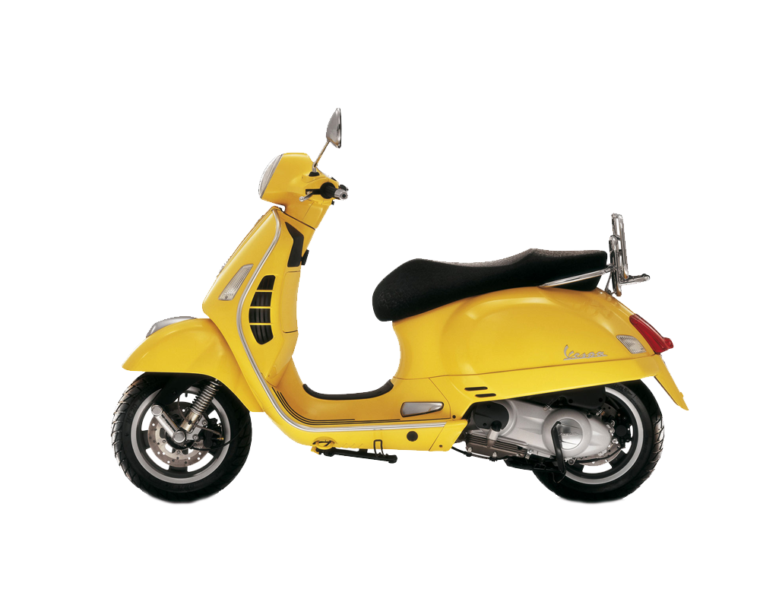
Is this force balanced or unbalanced?

Slide 9
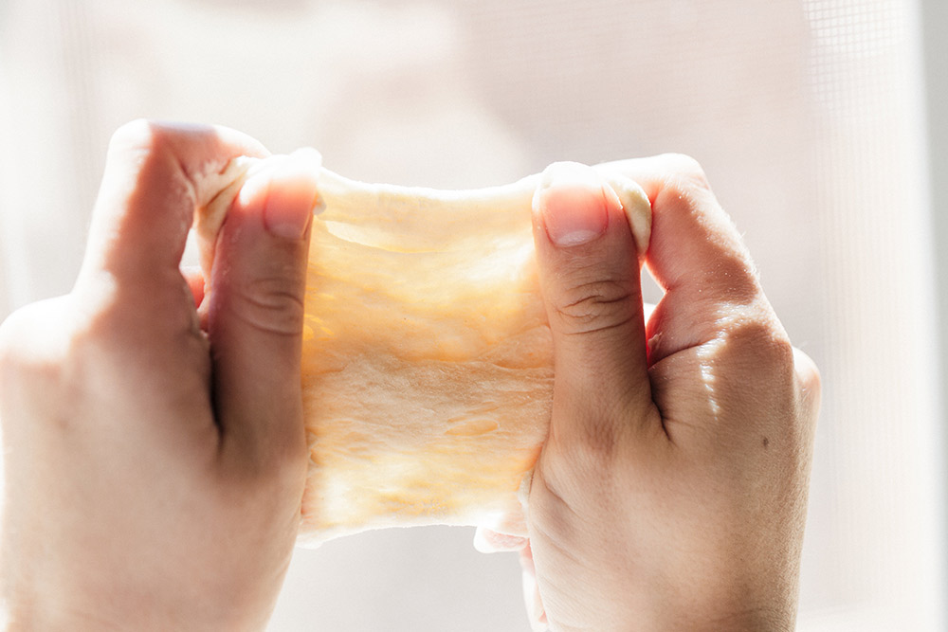
What is this force doing to the dough?

Slide 10
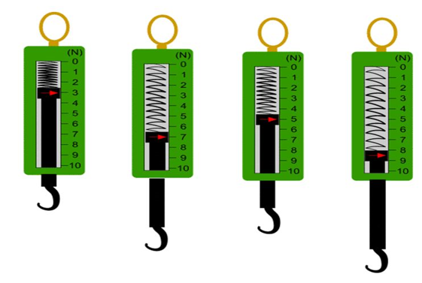
What measurement would this be in newtons?
_____ N

Slide 11
What measurement would this be in newtons?
_____ N

Slide 12
We will investigate net forces
TRACK WITH ME
READ WITH ME
We will draw force diagrams using arrows of scaled length.
We will calculate net force in newtons from force diagrams.
DECLARE THE OBJECTIVE
Read the learning objective to your partner.
Notes:
Learning Objectives contain concepts (nouns, big ideas), skills (verbs, measurable behaviours) and sometimes context (restricting or targeting conditions).
●Example: Students will be able to describe the concept of density and apply it to floating and sinking.
●
Success criteria are specific measurable outcomes that if met mean that the student has met the learning objective.
Examples:
•Students will be able to compare densities of substances using mass and volume.
•Students will be able to identify whether a solid or liquid will float or sink in a liquid based on their densities.

Slide 13


We will calculate net force using force diagrams.
Balanced forces are equal forces in opposite directions. There is no movement. The object stays still.
Unbalanced forces are unequal forces in opposite directions. There is movement in the direction of the greater force.
Using arrows, draw an example of an unbalanced force?
MAKE THE CONNECTION
Students, you already know forces can be balanced or unbalanced. We use arrows to show forces on an object.

Slide 14
We will calculate net force using force diagrams.
Force₁ diagrams₂ show how forces impact familiar objects.
The diagrams show familiar objects with arrows revealing the directions and size of the forces. They also have the amount of newtons for the forces.
The diagram below shows the forces on a soccer ball.
CHECK FOR UNDERSTANDING
What do force diagrams show? In which direction would the soccer ball move? Left or right? Explain your answer.
40N
5N
VOCABULARY
1 - a push, pull or twist. 2 - an image to easily represent information

Slide 15
We will calculate net force using force diagrams.
CHECK FOR UNDERSTANDING
With the car below, what is the greatest force? Which way does this force move the car? What causes the rocket to launch? Pair-Share
The size of the arrow shows the size of the force.
The bigger the arrow, the greater the force.
When forces are unbalanced, the object will move in the direction of the greatest force.
300N
100N
40N
5N

Slide 16
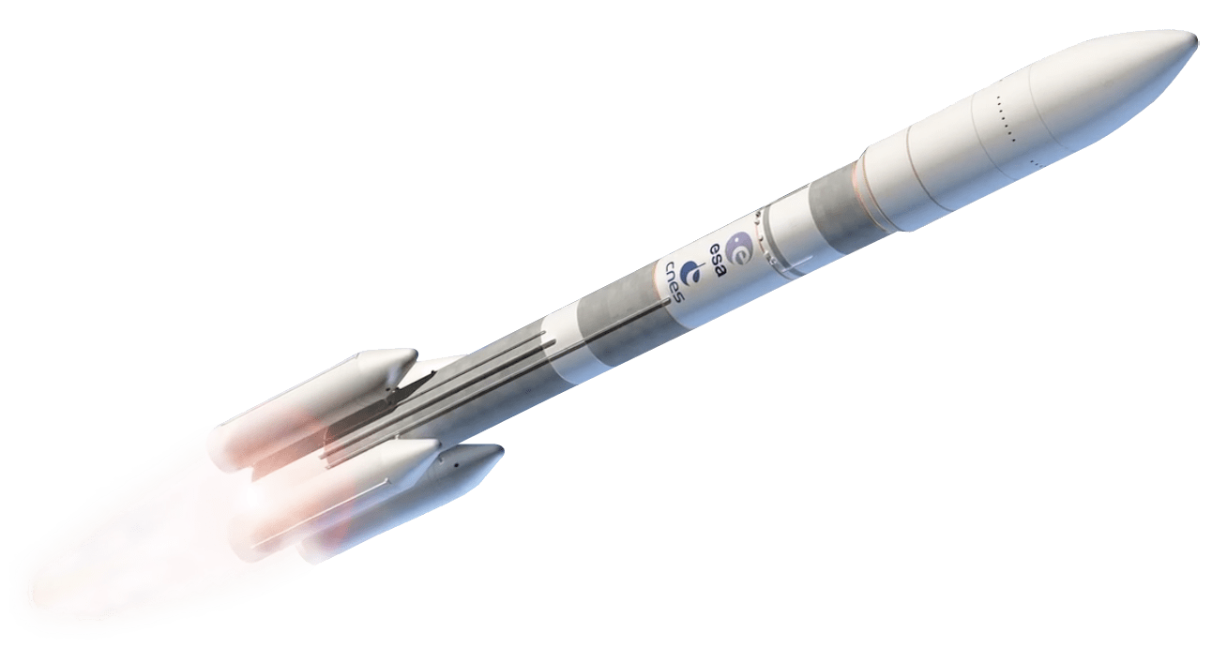
We will calculate net force using force diagrams.
CHECK FOR UNDERSTANDING
How do you calculate the net force? What would the net force of the rocket be (including units and direction)? Pair-Share Whiteboards
When force diagrams show the force as a number, we can calculate the net force.
The net force is the sum of all forces acting upon an object.
Net force = 35N Left
1000N
40N
5N
200N

Slide 17
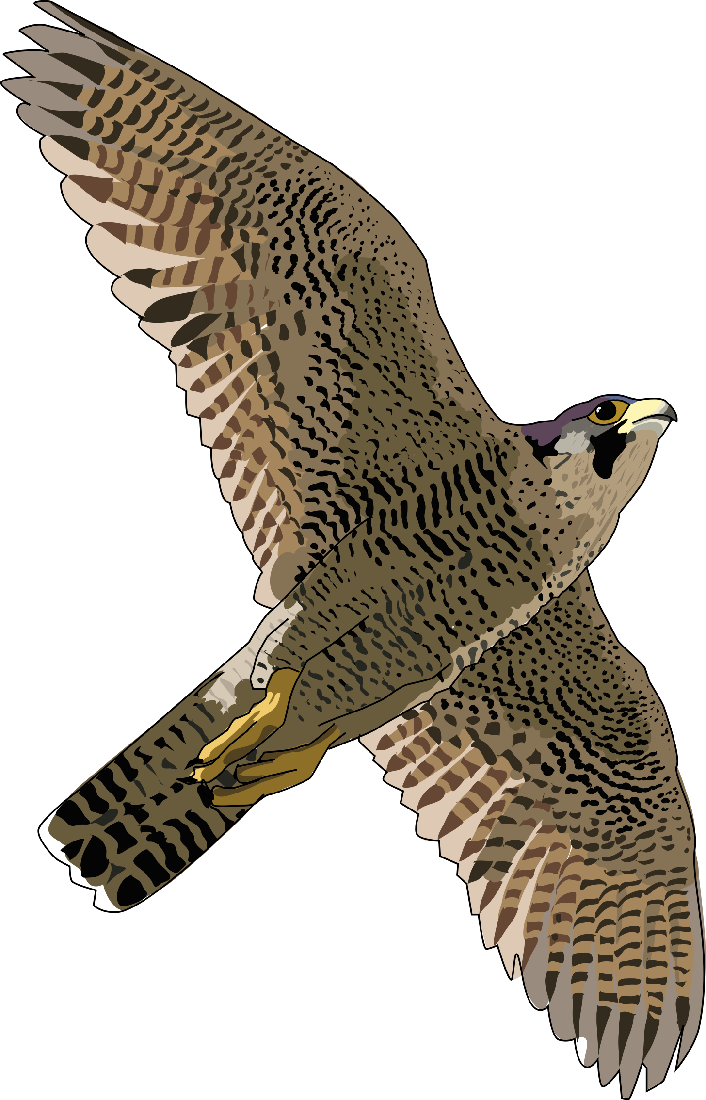
We will calculate net force using force diagrams.
What is the net force₁ of the falcon in the diagram₂?
MAKE THE CONNECTION
Students, remember that net forces can be calculated by adding all the forces acting on the object.
50N
200N
VOCABULARY
1 - a push, pull or twist. 2 - an image to easily represent information

Slide 18
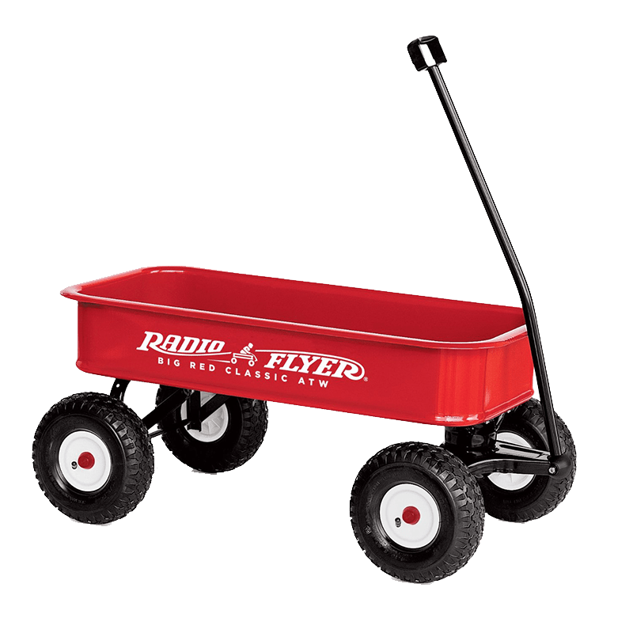
We will calculate net force using force diagrams.
What is the net force₁ of the wagon in the diagram₂?
MAKE THE CONNECTION
Students, remember that net forces can be calculated by adding all the forces acting on the object.
8N
20N
VOCABULARY
1 - a push, pull or twist. 2 - an image to easily represent information

Slide 19

We will calculate net force using force diagrams.
What is the net force₁ of the weightlifter in the diagram₂?
MAKE THE CONNECTION
Students, remember that net forces can be calculated by adding all the forces acting on the object.
50N
25N
VOCABULARY
1 - a push, pull or twist. 2 - an image to easily represent information

Slide 20

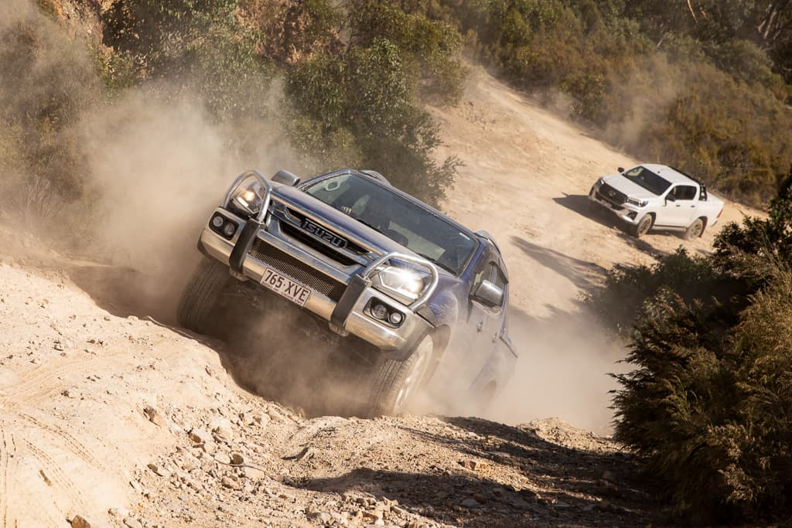

We will calculate net force using force diagrams.
Draw a force diagram and calculate the net force for the following examples:
A truck is travelling along a road with 60 newtons pushing it forward and 30 newtons pulling it back.
A cricket ball is thrown with 48 newtons of force. 22 newtons of force push it back as it hits the air.
MAKE THE CONNECTION
Students, remember that net forces can be calculated by adding all the forces acting on the object.
2 minutes

Slide 21


We will calculate net force using force diagrams.
If you can calculate net forces, you will be able to calculate the force required to move an object.
Calculating net force helps us understand which direction an object is moving and with how much force.
CHECK FOR UNDERSTANDING
Draw a force diagram showing the man unable to push a car. Pair-Share Whiteboards

Slide 22
We will calculate net force using force diagrams.
CHECK FOR UNDERSTANDING
What is the net force acting upon the rocket?
The strength of forces can be shown in diagrams by the size of arrows, or the values written on the arrows.
The bigger the arrow, the bigger the force.
The smaller the arrow, the smaller the force.
We can calculate the net force acting on an object by adding all the forces acting on the object.
3000N
200N

Slide 23
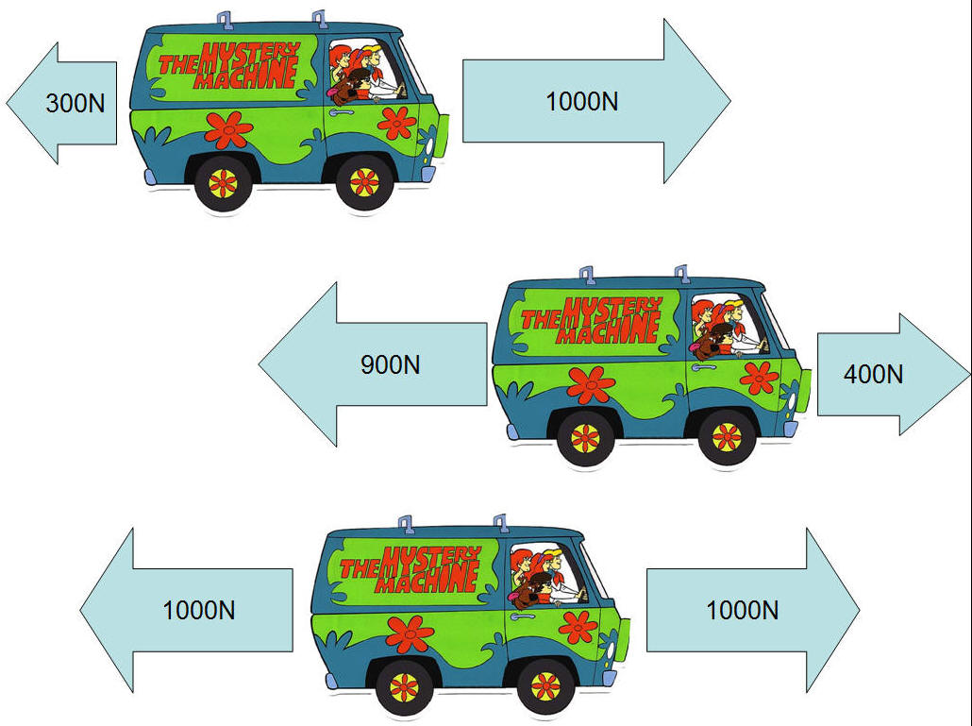
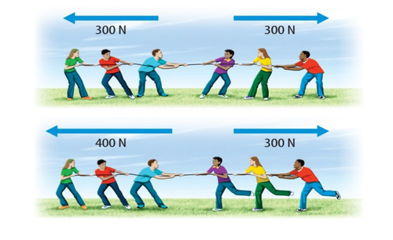
We will calculate net force using force diagrams.
HINT
Students, remember that net forces are calculated by adding all the forces acting upon the object together. Don’t forget about the direction of the object.
Answer the questions below in your book.
Where have you seen unbalanced forces? Sketch 3 force diagrams.
Calculate the net force for the following force diagrams.
C
A
D
5 minutes
B
E
Notes:
Please include tasks/questions here rather than just referring to a worksheet. This will save on photocopying and facilitate sharing with other schools.
Try and build tasks/questions which escalate through Bloom’s Taxonomy. This will help with differentiation.

Slide 24
We will calculate net force using force diagrams.
We will draw force diagrams using arrows of scaled length.
We will calculate net force in newtons from force diagrams.
CHECK FOR UNDERSTANDING
Check Success Criteria.
Notes:
Learning Objectives contain concepts (nouns, big ideas), skills (verbs, measurable behaviours) and sometimes context (restricting or targeting conditions).
●Example: Students will be able to describe the concept of density and apply it to floating and sinking.
●
Success criteria are specific measurable outcomes that if met mean that the student has met the learning objective.
Examples:
•Students will be able to compare densities of substances using mass and volume.
•Students will be able to identify whether a solid or liquid will float or sink in a liquid based on their densities.

